Slide 1
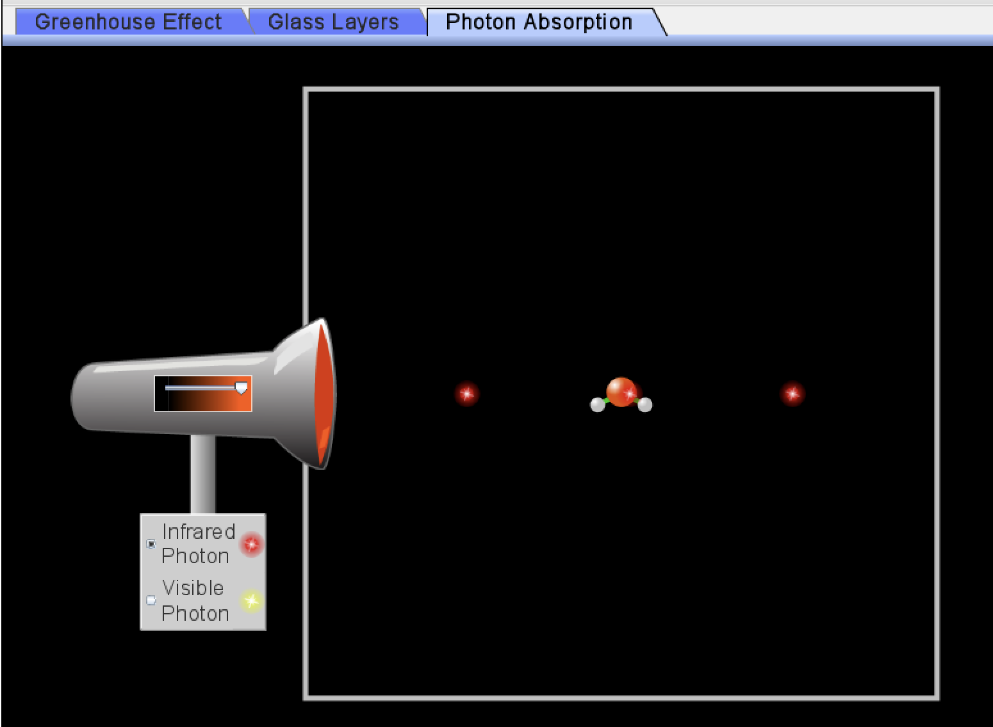
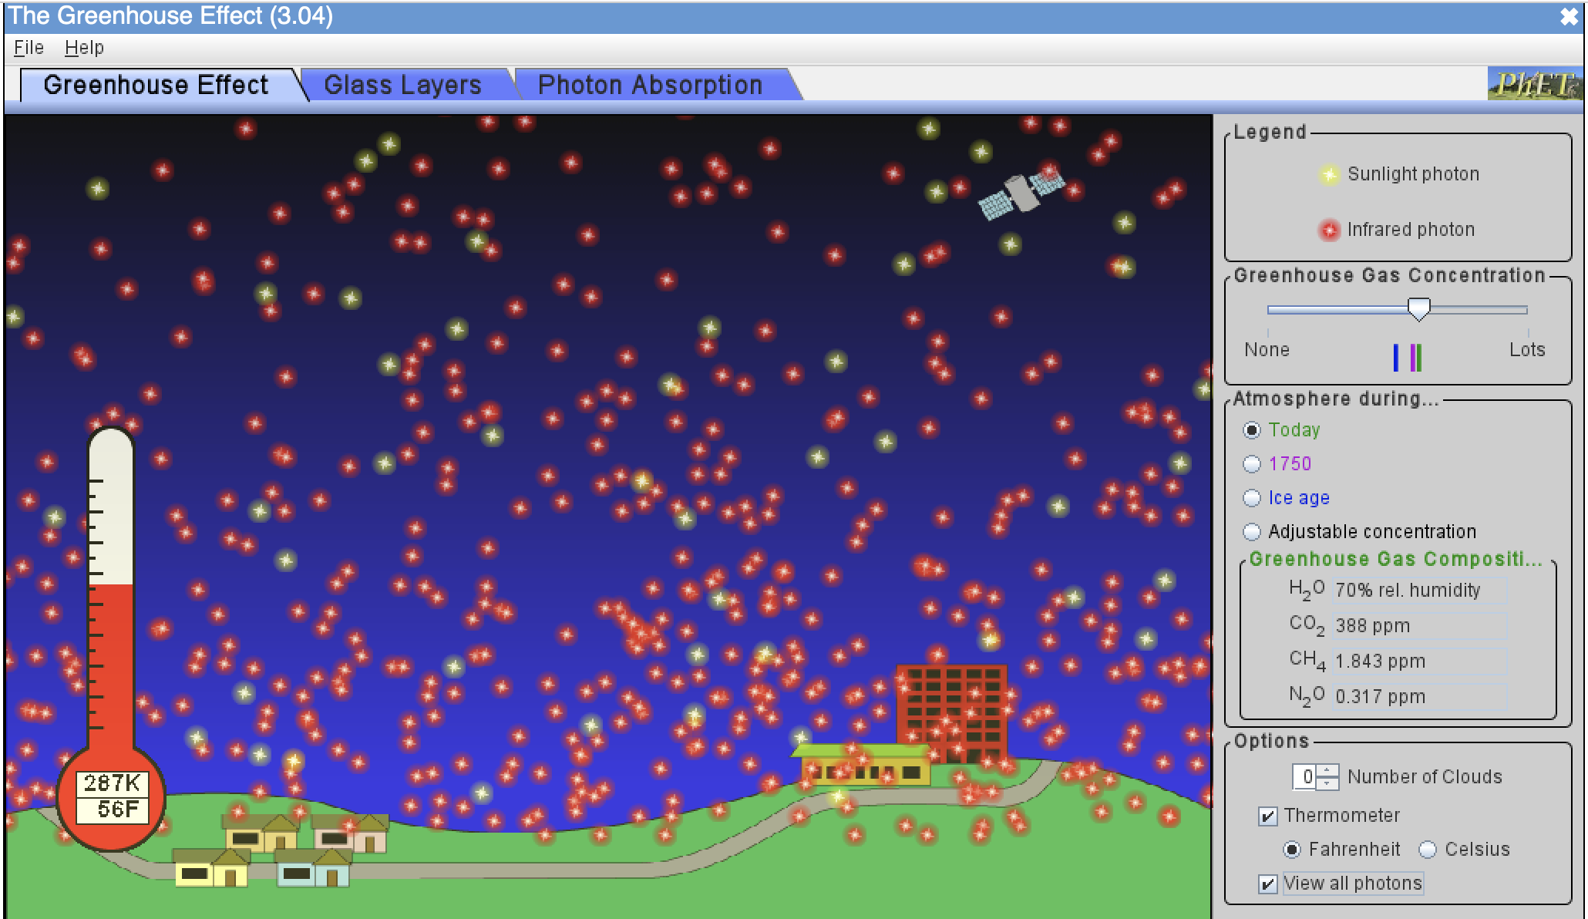
Recap: Let’s talk about the concepts of radiative balance, SW, LW, and homeostasis
What kind of light (SW or LW) do GHG molecules absorb?
What happens to those molecules when they absorb that light?
Assuming radiative balance, why are there more LW photons leaving Earth than SW photons coming in?
What seems to be the homeostatic temperature (in degrees K, C, F) with default settings?
How much colder was it back in 1750 compared to now?
How much colder was it during ice ages compared to now?
What effect do clouds have on SW photons?
On LW photons?
On temperature?
https://phet.colorado.edu/sims/cheerpj/greenhouse/latest/greenhouse.html?simulation=greenhouse

Slide 2
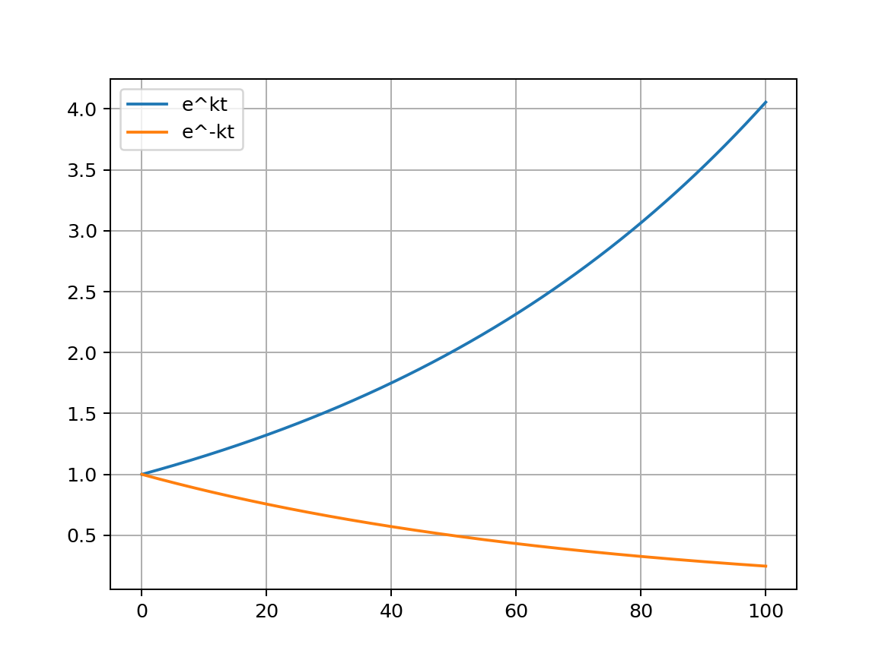
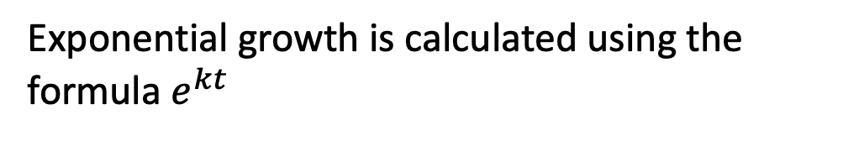

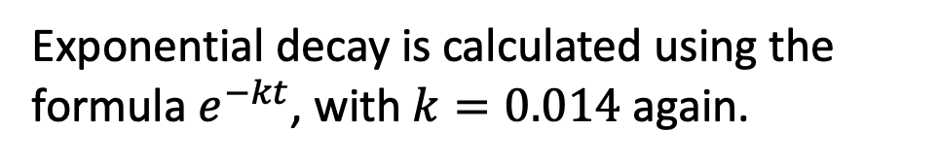
To do this in Python, we’ll need some coding skills. On the way, it’ll be useful to pick up a little vocabulary about exponential growth and decay
Exponential growth is calculated using the formula $e^{kt}$
exponential growth
$$k=0.014$$
exponential decay
Exponential decay is calculated using the formula $e^{−kt}$, with $k=0.014$ again.
time
time

Slide 3
To do this in Python, we’ll need some coding skills. On the way, it’ll be useful to pick up a little vocabulary about exponential growth and decay: doubling time and half-lives
Exponential growth has a special quality you can see here:
How long did it take to get from 1 to 2?
exponential growth
$$k=0.014$$
time

Slide 4
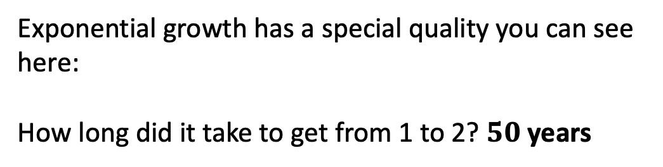
To do this in Python, we’ll need some coding skills. On the way, it’ll be useful to pick up a little vocabulary about exponential growth and decay: doubling time and half-lives
Exponential growth has a special quality you can see here:
How long did it take to get from 1 to 2? $50$ years
exponential growth
$$k=0.014$$
time

Slide 5
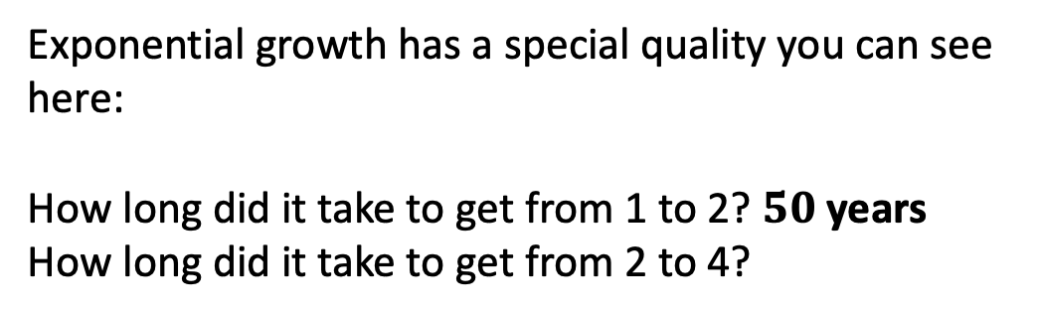
To do this in Python, we’ll need some coding skills. On the way, it’ll be useful to pick up a little vocabulary about exponential growth and decay: doubling time and half-lives
Exponential growth has a special quality you can see here:
How long did it take to get from 1 to 2? $50$ years
How long did it take to get from 2 to 4?
exponential growth
$$k=0.014$$
time

Slide 6
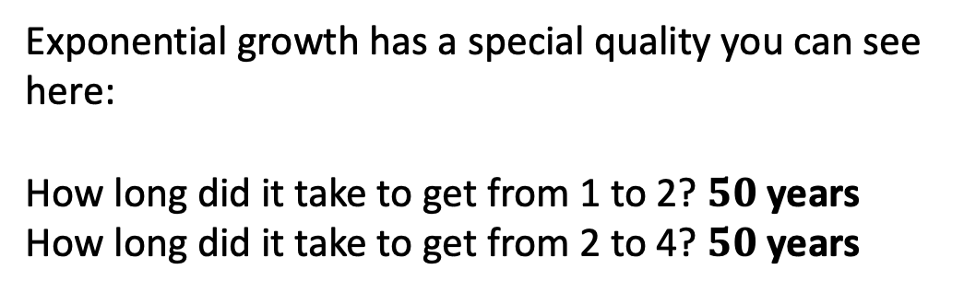
To do this in Python, we’ll need some coding skills. On the way, it’ll be useful to pick up a little vocabulary about exponential growth and decay: doubling time and half-lives
Exponential growth has a special quality you can see here:
How long did it take to get from 1 to 2? $50$ years
How long did it take to get from 2 to 4? $50$ years
exponential growth
$$k=0.014$$
time

Slide 7
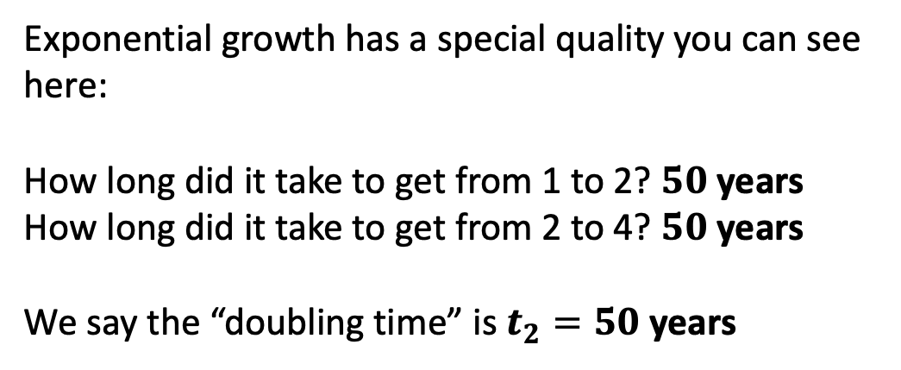
To do this in Python, we’ll need some coding skills. On the way, it’ll be useful to pick up a little vocabulary about exponential growth and decay: doubling time and half-lives
Exponential growth has a special quality you can see here:
How long did it take to get from 1 to 2? $50$ years
How long did it take to get from 2 to 4? $50$ years
We say the “doubling time” is $t_{2}=50$ years
exponential growth
$$k=0.014$$
time

Slide 8
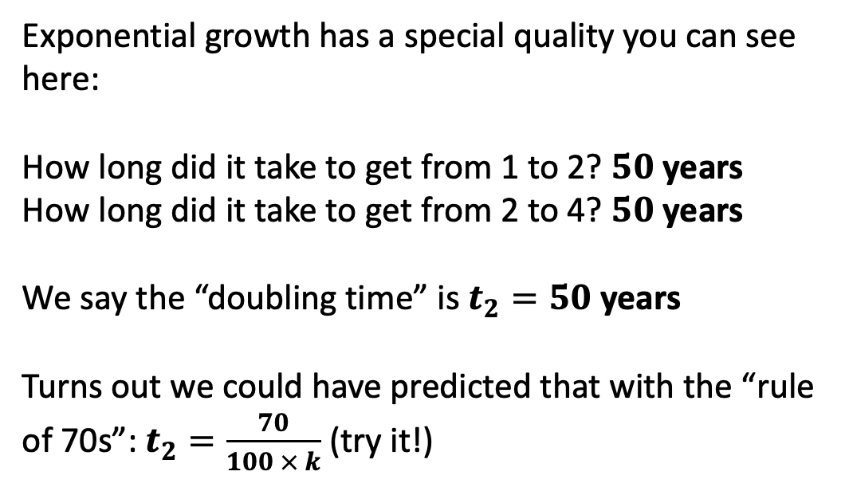
To do this in Python, we’ll need some coding skills. On the way, it’ll be useful to pick up a little vocabulary about exponential growth and decay: doubling time and half-lives
Exponential growth has a special quality you can see here:
How long did it take to get from 1 to 2? $50$ years
How long did it take to get from 2 to 4? $50$ years
We say the “doubling time” is $t_{2}=50$ years
Turns out we could have predicted that with the “rule of 70s”: $t_{2}=\frac{70}{100 × k}$ (try it!)
exponential growth
$$k=0.014$$
time

Slide 9
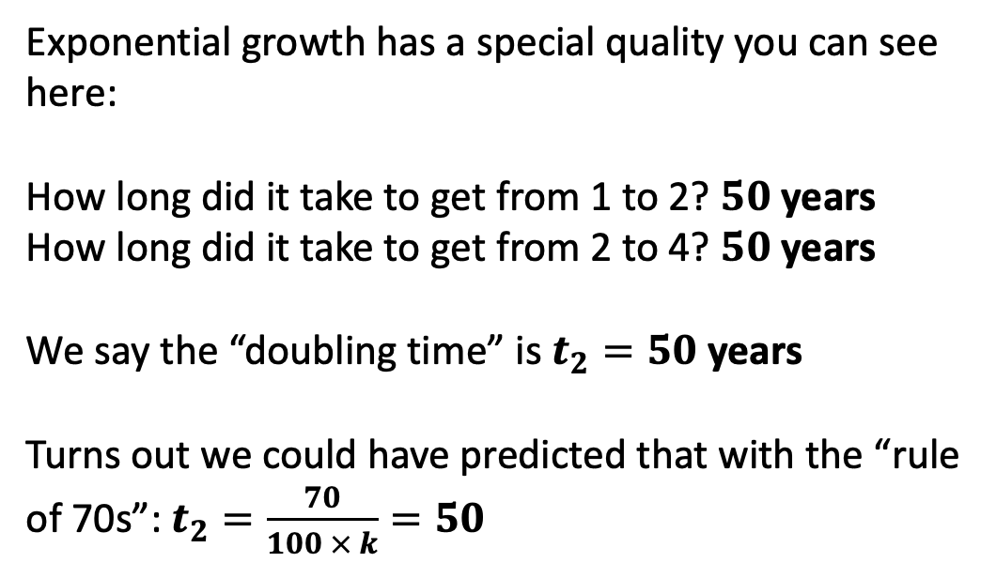
To do this in Python, we’ll need some coding skills. On the way, it’ll be useful to pick up a little vocabulary about exponential growth and decay: doubling time and half-lives
Exponential growth has a special quality you can see here:
How long did it take to get from 1 to 2? $50$ years
How long did it take to get from 2 to 4? $50$ years
We say the “doubling time” is $t_{2}=50$ years
Turns out we could have predicted that with the “rule of 70s”: $t_{2}=\frac{70}{100 × k}=50$
exponential growth
$$k=0.014$$
time

Slide 10
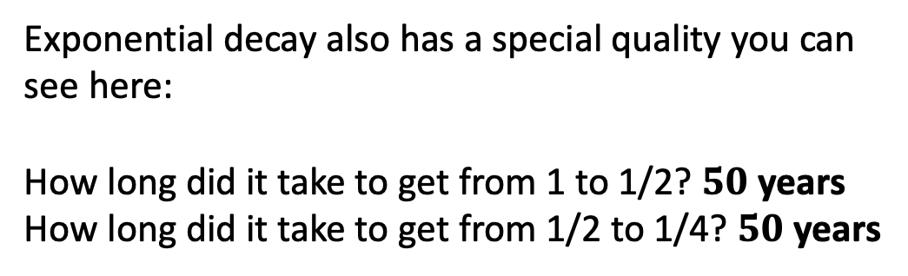
To do this in Python, we’ll need some coding skills. On the way, it’ll be useful to pick up a little vocabulary about exponential growth and decay: doubling time and half-lives
Exponential decay also has a special quality you can see here:
How long did it take to get from 1 to 1/2? $50$ years
How long did it take to get from 1/2 to 1/4? $50$ years
$$k=0.014$$
exponential decay
time

Slide 11
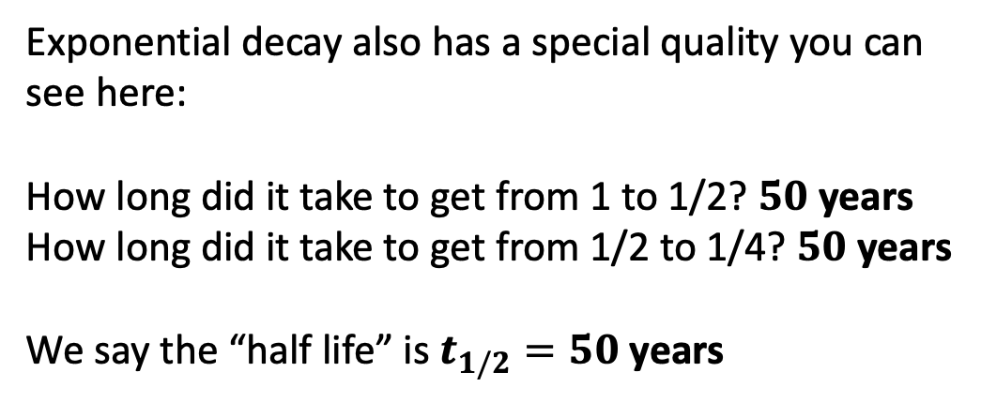
To do this in Python, we’ll need some coding skills. On the way, it’ll be useful to pick up a little vocabulary about exponential growth and decay: doubling time and half-lives
Exponential decay also has a special quality you can see here:
How long did it take to get from 1 to 1/2? $50$ years
How long did it take to get from 1/2 to 1/4? $50$ years
We say the “half life” is $t_{1/2}=50$ years
$$k=0.014$$
exponential decay
time

Slide 12
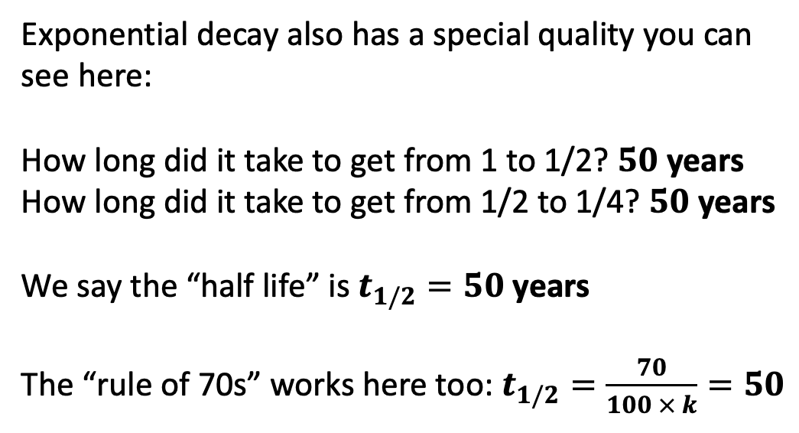
To do this in Python, we’ll need some coding skills. On the way, it’ll be useful to pick up a little vocabulary about exponential growth and decay: doubling time and half-lives
Exponential decay also has a special quality you can see here:
How long did it take to get from 1 to 1/2? $50$ years
How long did it take to get from 1/2 to 1/4? $50$ years
We say the “half life” is $t_{1/2}=50$ years
The “rule of 70s” works here too: $t_{1/2}=\frac{70}{100 × k}=50$
$$k=0.014$$
exponential decay
time

Slide 13
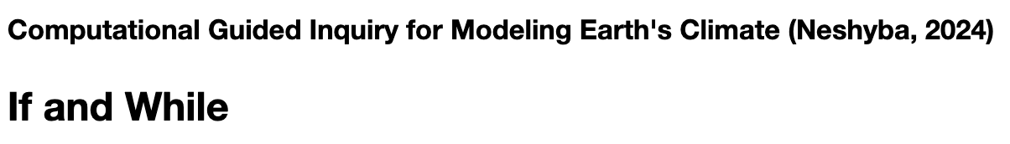
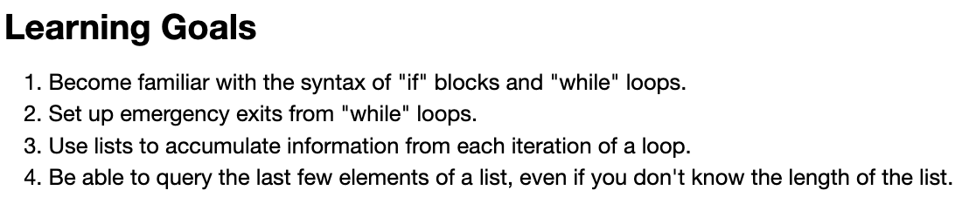

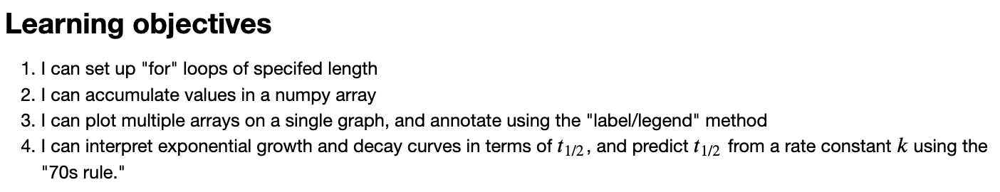
Let’s get started …

